Slide 1
Operating System
Chapter 2: Processes and Threads
宫晓利
Department of Computer Science, NanKai University
Email: gongxiaoli@nankai.edu.cn

Slide 2
经典IPC问题

Slide 3
Communication between processes
Issues about Inter process Communication
Asynchronism: pass information to other processes
Exclusion: compete with other processes for some resource
Synchronism: maintain proper running sequence
Difficulty of Interprocess communication
Information format: signal, switch, message
Exclusion and synchronism: cooperation issues
Pyramid rules
20% difficult problems and 80% easy problems
20% energy for 80% easy problems, while 80% energy for 20% difficult problems

Slide 4
Exclusion: Spooler directory
Spooler Dir
Out：4
In：7
………
4：File1
Proc A：N_f_s = In; //In == 7
InsertFileIntoSpooler(N_f_s);
In=N_f_s++; //In == 8
5：File2
6：File3
7：Null
8：Null
CPU switch (Correct)
………
Proc B：N_f_s = In; //In == 8
InsertFileIntoSpooler(N_f_s);
In=N_f_s++; //In == 9

Slide 5
Exclusion: Spooler directory
Spooler Dir
Out：4
In：7
………
4：File1
Proc A：N_f_s = In; //In == 7
5：File2
CPU switch
6：File3
Proc B：N_f_s = In; //In == 7
InsertFileIntoSpooler(N_f_s);
In=N_f_s++; //In == 8
7：Null
8：Null
………
CPU switch, Proc B lost data
Proc A： InsertFileIntoSpooler(N_f_s);
In=N_f_s++; //In == 8

Slide 6

现实生活中的并发问题
■
操作系统和现实生活的问题类比
利用现实生活问题帮助理解操作系统同步问题
同时注意，计算机与人的差异
■
例如: 家庭采购协调
时 间
A
B
3:00
查看冰箱，没有面包了
3:05
离开家去商店
3:10
到达商店
查看冰箱，没有面包了
3:15
购买面包
离开家去商店
3:20
到家，把面包放进冰箱
到达商店
3:25
购买面包
3:30
到家，把面包放进冰箱

Slide 7
家庭采购协调问题分析
■
如何保证家庭采购协调的成功和高效
有人去买
需要采购时，有人去买面包
最多只有一个人去买面包
■
可能的解决方法
在冰箱上设置一个锁和钥匙（ lock&key）
去买面包之前锁住冰箱并且拿走钥匙
■
加锁导致的新问题
冰箱中还有其他食品时，别人无法取到

Slide 8
方案一
■
使用便签来避免购买太多面包
购买之前留下一张便签
买完后移除该便签
别人看到便签时，就不去购买面包
if (nobread) { if (noNote) { leave Note; buy bread; remove Note; } }
■
有效吗？

Slide 9
方案一分析
■
偶尔会购买太多面包
检查面包和便签后帖便签前，有其他人检查面包和便签
■
解决方案只是间歇性地失败
进程A
进程B
if (nobread) { if (noNote) {
必须考虑调度器所做的事情
if (nobread) { if (noNote) {
leave Note;
buy bread;
remove Note; }
}
leave Note;
buy bread;
leave Note;
buy bread;
remove Note; }
}
leave Note;
buy bread;

Slide 10
方案二
■
先留便签，后检查面包和便签。
leave Note;
if (nobread) { if (noNote) { buy bread; }
}
remove note;
■
会发生什么？
不会有人买面包，因为这个方案是错误的

Slide 11
方案三
■
会发生什么？
■
为便签增加标记，以区别不同人的便签
可能导致没有人去买面包
现在可在检查之前留便签
每个人都认为另外一个去买面包
进程A
进程B
leave note_1;
leave note_1;
if (no note_2) {
if (no bread) {
buy bread;
}
}
remove note_1;
leave note_2;
if (no note_1) {
if (no bread) {
buy bread;
}
}
remove note_2;
leave note_2;
if (no note_2) {
if (no bread) {
buy bread;
}
}
if (no bread) {
buy bread;
}
if (no note_1) {
if (no bread) {
buy bread;
}
}
remove note_2;
if (no bread) {
buy bread;
}
remove note_1;

Slide 12
方案四
■
两个人采用不同的处理流程
进程A
进程B
leave note_1;
while(note_2) {
do nothing;
}
if(no bread){
buy bread;
}
remove note_1;
leave note_2;
if(no note_1) {
if(no bread){
buy bread;
}
}
remove note_2;
如果没有便签2,那么A可以去买面包，否则等待B离开
如果没有便签1,那么B可以去买面包，否则B离开并且再试一次
■
现在有效吗？
枚举所有可能后，可以确认它是有效的
■
这种解决方案你满足吗？

Slide 13
方案四分析
■
它有效，但太复杂
很难验证它的有效性
■
A和B的代码不同
每个进程的代码也会略有不同
如果进程更多，怎么办？
■
当A在等待时，它不能做其他事
忙等待（busy-waiting）
■
有更好的方法吗？

Slide 14
Concept about mutual exclusion
Race condition
More than one processes are compete for some exclusive resource, other processes shouldn’t access the resource when a process is occupying the resource
在单处理器的情况下，竞争是由一片连续的代码访问某个共享资源造成的。本该连续执行的代码，由于调度变得零碎而导致出错
多处理器的情况下，因为有两个进程（线程）在并行执行，问题会更加严重（本课程暂不考虑这种复杂的情况）

Slide 15
临界区(Critical Section)
entry section
critical section
exit section
remainder section
entry section
critical section
exit section
remainder section
■ 临界区(critical section)
■ 进入区(entry section)
进程中访问临界资源的一段需要互斥执行的代码
检查可否进入临界区的一段代码
如可进入，设置相应"正在访问临界区"标志
■ 退出区(exit section)
清除“正在访问临界区”标志
■ 剩余区(remainder section)
代码中的其余部分

Slide 16
Concept about mutual exclusion
A enters critical region
A leaves critical region
Proc A
B try to enter CR
B enters CR
B leaves CR
Proc B
Blocked
T1
T2
T3
T4
Time

Slide 17
临界区的访问规则
■ 空闲则入
■ 忙则等待
■ 有限等待
■ 让权等待（可选）
Notes:
17

Slide 18
临界区的访问规则
■ 空闲则入
没有进程在临界区时，任何进程可进入
■ 忙则等待
■ 有限等待
■ 让权等待（可选）
Notes:
18

Slide 19
临界区的访问规则
■ 空闲则入
■ 忙则等待
有进程在临界区时，其他进程均不能进入临界区
■ 有限等待
■ 让权等待（可选）
Notes:
19

Slide 20
临界区的访问规则
■ 空闲则入
■ 忙则等待
■ 有限等待
等待进入临界区的进程不能无限期等待
■ 让权等待（可选）
Notes:
20

Slide 21
临界区的访问规则
■ 空闲则入
■ 忙则等待
■ 有限等待
■ 让权等待（可选）
不能进入临界区的进程，应释放CPU（如转换到阻塞状态）
Notes:
21

Slide 22
Disabling interrupts
Proc A
Close_INT;
Critical_region();
Open_INT;
Proc B
Close_INT;
Critical_region();
Open_INT;
Strongpoint
Solve mutual exclusion problems drastically
Weakness
Dangerous for users can close interrupts
Useless under multiple CPUs condition

Slide 23
Solutions of IPC problems
Busy waiting
Sleep and wakeup
Message passing

Slide 24
Busy waiting
Design rules
Set a global variable to store the status of CR
Process checks this variable before enters CR
Methods
Lock variables
Strict alternation
Peterson’s solution
TSL instruction

Slide 25
Lock variable
Lock ＝ 0
Proc A
While(lock != 0);
lock ＝ 1;
Critical_region();
lock ＝ 0；
Proc B
While(lock != 0);
lock = 1;
Critical_region();
lock = 0;
Weakness
Doesn’t resolve the problem essentially

Slide 26
Drawback of lock variable
Lock ＝ 0
Proc A
While(lock != 0);
CPU switch
Proc B
While(lock != 0);
Proc A
lock ＝ 1;
Critical_Region();
CPU switch, Proc A enters CR
Proc B
lock = 1;
Critical_Region();
CPU switch, Proc B enters CR

Slide 27
Strict alternation
turn ＝ 0
Proc A
While(TRUE)
{
While(turn != 0);
Critical_region();
turn ＝ 1；
Nocritical_region();
}
Proc B
While(TRUE)
{
While(turn != 1);
Critical_region();
turn ＝ 0；
Nocritical_region();
}
Weakness
Waste CPU time
Processes have to be running alternately

Slide 28
Drawback of strict alternation
turn ＝ 0
Proc A
Enter-Leave CR;
Nocritical_region();
Proper sequence in first turn
Proc B
Enter-Leave CR; Nocritical_region();
Wait for entering CR
Proc B wait for next turn, but proc A blocked proc B while proc A is not in CR

Slide 29
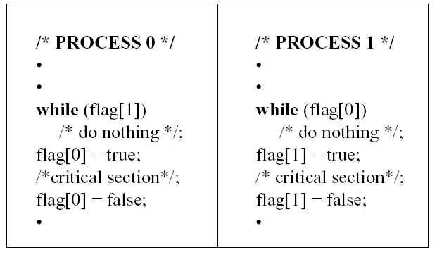
第二种尝试：每个进程用一个布尔量标征自己的状态，类似自旋锁功能。
缺点：一进程在临界区内失败会阻塞另一进程；临界区会进入多进程。
29

Slide 30
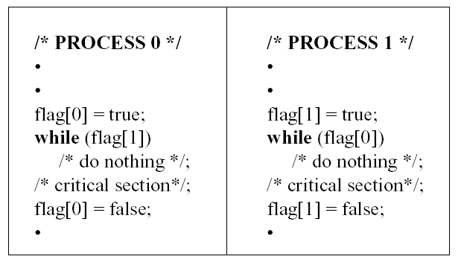
第三次尝试：把flag[*]=true换到前面
问题：若两进程flag同时被置成true,又没有进入临界区，将产生死锁。
30

Slide 31
Peterson算法
■
满足线程Ti和Tj之间互斥的经典的基于软件的解决方法（1981年）
■
共享变量
int turn;
boolean flag[];
//表示该谁进入临界区
//表示进程是否准备好进入临界区
■
进入区代码
flag[i] = true;
turn = j;
while (flag[j] && turn ==j)
■
退出区代码
flag[i] = false;

Slide 32
Peterson算法实现
线程Ti 的代码
do {
flag[i] = true;
turn = j;
while ( flag[j] && turn == j);
CRITICAL SECTION
flag[i] = false;
REMAINDER SECTION
} while (true);

Slide 33
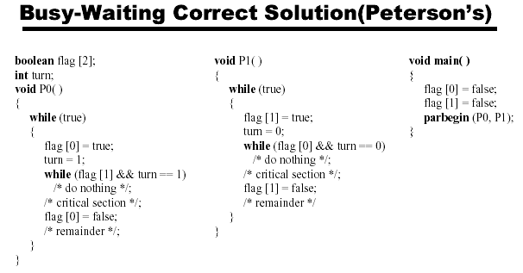
Peterson算法示意分析
33

Slide 34
Dekkers算法
线程Ti 的代码
flag[0]:= false; flag[1]:= false; turn:= 0;//or1
do {
flag[i] = true;
while flag[j] == true {
if turn ≠ i {
flag[i] := false
while turn ≠ i { }
flag[i] := true
}
}
CRITICAL SECTION
turn := j
flag[i] = false;
EMAINDER SECTION
} while (true);

Slide 35
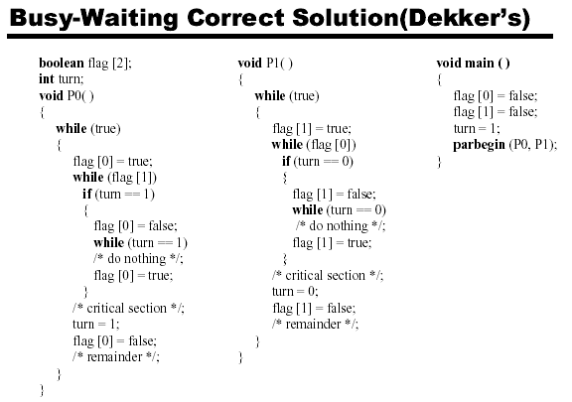
Dekker算法示意分析
35

Slide 36
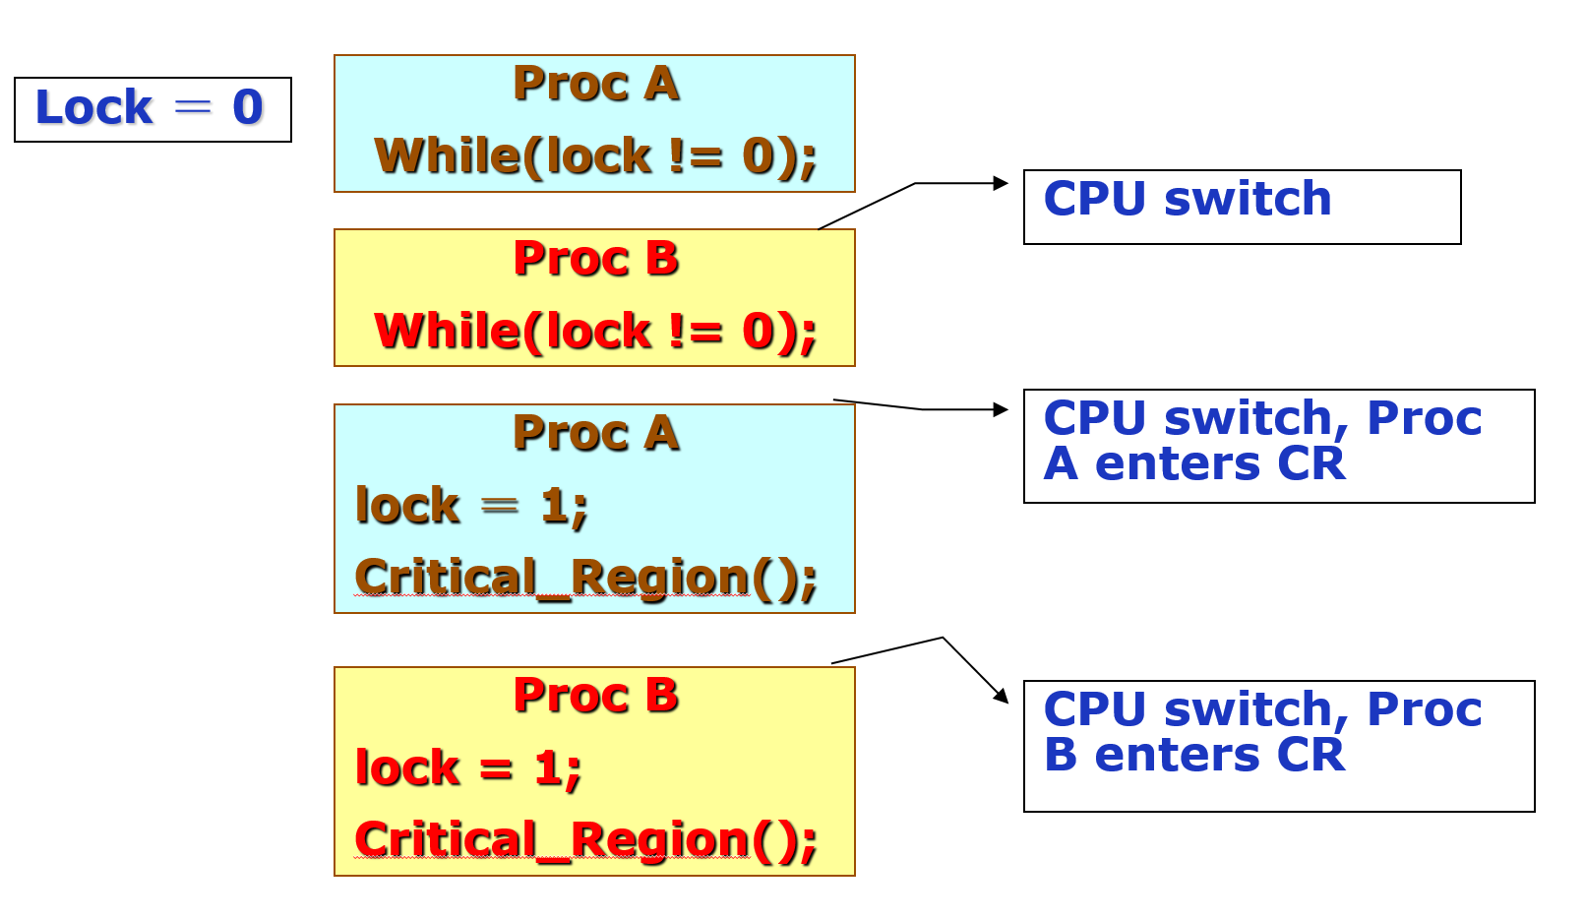
Test and Set Lock (TSL)solution
TSL RX LOCK
1)TSL is a hardware instruction
2)LOCK is a memory word
3)Store value of LOCK to RX and set nonzero value to LOCK
enter_region：
TSL REGISTER，LOCK
CMP REGISTER, #0
JNE enter_region
RET
leave_region:
MOVE LOCK #0
RET
版权所有，转载请注明出处
检查和赋值之间的调度行为是万恶之源

Slide 37
使用TS指令实现自旋锁(spinlock)
class Lock {
int value = 0;
}
如果锁被释放，那么TS指令读取0并将值设置为1
锁被设置为忙并且需要等
待完成
Lock::Acquire() {
while (test-and-set(value))
; //spin
}
如果锁处于忙状态，那么TS指令读取1并将值设置为1
不改变锁的状态并且需要
循环
Lock::Release() {
value = 0;
}
线程在等待的时候消耗CPU时间

Slide 38
锁(lock)
■
锁是一个抽象的数据结构
一个二进制变量（锁定/解锁）
Lock::Acquire()
Lock::Release()
锁被释放前一直等待，然后得到锁
Lock::Release()
释放锁，唤醒任何等待的进程
■
使用锁来控制临界区访问
lock_next_pid->Acquire();
new_pid = next_pid++ ;
lock_next_pid->Release();

Slide 39
Analysis of “Busy waiting”
Strong
Resolve mutual exclusion problem between 2 processes
Weakness
Waste CPU time
Difficult to programming
Has risk that may be cause priority inversion problem
Trend
Atomic action: The most important thing
Opportunity
It is the basement for advanced solution

Slide 40
无忙等待锁
忙等待
无忙等待
Lock::Acquire() {
while (test-and-set(value))
; //spin
}
Lock::Release() {
value = 0;
}
class Lock {
int value = 0;
WaitQueue q;
}
Lock::Acquire() {
while (test-and-set(value)) {
add this TCB to wait queue q;
schedule();
}
}
Lock::Release() {
value = 0;
remove one thread t from q;
wakeup(t);
}

Slide 41

Sleep-Wake up
Design rules
OS provide “atomic action” mechanism, a special kind of system call
Blocked process will sleep until it is waken up
CPU is not wasted, both mutual exclusion and Synchronism can be resolved via this mechanism
Methods
Simple sleep-wake up solution
Semaphore solution
Monitor solution

Slide 42
Simple Sleep-Wake up solution
Primitive: atomic action supported by OS
Sleep(): block the caller process
Wakeup(PID):wake the process whose ID is PID
Application
Check race condition
If the race condition is not available, call Sleep
When the mutual exclusion process leave the CR, it will wake up the sleep process
Risk: the waking up signal may be lost, extended data structure should be designed for stability
Disadvantage: this solution is not universal and efficient for multiple processes

Slide 43
Solution of “Producer-Consumer”
＃define N 100
int lock ＝ 0
int count = 0
Producer
While(TRUE)
{
Produce-Item();
if(count == N)
sleep();
Enter-item();
count = count + 1
if(count == 1)
wakeup(consumer);
}
Comsumer
While(TRUE)
{
if(count == 0)
sleep();
Remove-Item();
count = count - 1
if(count == N-1)
wakeup(producer);
Consume-item();
}

Slide 44
Disadvantage of this solution
Consumer
… … … … …
if(count == 0)
＃define N 100
int lock ＝ 0
int count = 0
CPU switch, consumer doesn’t sleep
Producer
… … … …
wakeup(consumer);
Producer try to wake up consumer
Comsumer
sleep();
Consumer lost the wake up signal, and sleep
Producer
… … … …
Producer will fill the buffer to full, and sleep
Producer
sleep()；

Slide 45
Semaphore solution
Design rules
Semaphore: data structure supported by OS, stores the accumulate values of operations on race conditions
P/V primitives: operations on semaphore
Dijkstra: proposed Probern and Verhogen primitives in 1965
Application
Semaphore’s value: the total times of race condition checking caused by all related processes, >=0 means the environment is safe, <0 means the CR is unavailable
Down primitive: decrease the semaphores by 1, if < 0 then block current process
Up primitive: increase the semaphore by 1, if <= 0 then wake up process blocked by this semaphore

Slide 46



信号量(semaphore)
■
信号是一种抽象数据类型
由一个整形 (sem)变量和两个原子操作组成
P()
(Prolaag （荷兰语尝试减少）)
sem减1
如sem<0, 进入等待, 否则继续
■
信号量与铁路的类比
V()
(Verhoog （荷兰语增加）)
sem加1
2个站台的车站
2个资源的信号量
如sem≤0,唤醒一个等待进程

Slide 47
信号量的特性
■
信号量是被保护的整数变量
初始化完成后，只能通过P()和V()操作修改
由操作系统保证，PV操作是原子操作
■
P() 可能阻塞，V()不会阻塞
■
通常假定信号量是“公平的”
线程不会被无限期阻塞在P()操作
假定信号量等待按先进先出排队
另外的问题：自旋锁能否实现先进先出?

Slide 48
信号量的实现
classSemaphore {
int sem;
WaitQueue q;
}
Semaphore::P() {
sem--;
if (sem < 0) {
Add this thread t to q;
block(p);
}
}
Semaphore::V() {
sem++;
if (sem<=0) {
Remove a thread t from q;
wakeup(t);
}
}
PV函数的调用过程是原子的，在这个过程中不会发生中断或调度

Slide 49
用信号量实现临界区的伪码形式
每个临界区设置一个信号量，其初值为1
mutex = new Semaphore(1);
mutex->P();
Critical Section;
mutex->V();
■
必须成对使用P()操作和V()操作
P()操作保证互斥访问临界资源
V()操作在使用后释放临界资源
PV操作不能次序错误、重复或遗漏

Slide 50
Exclusion: Spooler directory with Semaphore
Spooler Dir
Semephore：1
Out：4
In：7
………
4：File1
P();
Proc A：N_f_s = In; //In == 7
InsertFileIntoSpooler(N_f_s);
In=N_f_s++; //In == 8
V();
5：File2
6：File3
7：Null
8：Null
………
P();
Proc B：N_f_s = In; //In == 8
InsertFileIntoSpooler(N_f_s);
In=N_f_s++; //In == 9
V();

Slide 51
Synchronism: Driver-Conductor
Driver
While(True)
{
Start bus；
Driving；
Stop bus；
}
Conductor
While(True)
{
Close door；
Sell ticket；
Open door；
}
Proper sequence
While(True)
{
(D)Start bus；
(C)Close door；
(D)Driving；
(C)Sell ticket;
(D)Stop bus；
(C)Open door；
}

Slide 52
Concept about Synchronism
Logical sequence
Caused by application purpose, can’t be predicted
May be broken by scheduling
Difference between synchronism and mutual exclusion
Mutual exclusion: prevent other process enter CR
Synchronism: realize the proper logical sequence
How to design proper method?
General: without assumption or limitation
Simple: easy to realize and maintain
Efficient and safe:

Slide 53
Analysis about IPC problem
Reason of IPC problem
Physical sequence: depends on scheduling
Logical sequence: depends on application purpose
Race condition: Exclusive resource allocation
IPC problem in kernel and user space
Kernel space: I/O device management
User space: network application, database…
Key of IPC problem
Realize both physical and logical sequence
The logical sequence is independent on scheduling
The logical sequence can be controlled by user

Slide 54
用信号量实现条件同步
每个条件同步设置一个信号量，其初值为0
condition = new Semaphore(0);
线程A
线程B
… M …
… N …
… X …
… Y …
condition->P();
condition->V();

Slide 55
Problem models of IPC
Producer-Consumer
Bounded-buffer problem
Dinning philosophers
Synchronism based on mutual exclusion
Reader-Writher
Multi-process synchronism based on mutual exclusion
Sleeping barber
Synchronism and mutual exclusion under complex application environment

Slide 56
生产者-消费者问题
生产者
消费者
生产者
消费者
缓冲区
■
有界缓冲区的生产者-消费者问题描述
一个或多个生产者在生成数据后放在一个缓冲区里
单个消费者从缓冲区取出数据处理
任何时刻只能有一个生产者或消费者可访问缓冲区

Slide 57
用信号量解决生产者-消费者问题
■
问题分析
（互斥访问）
（互斥访问）
任何时刻只能有一个线程操作缓冲区
缓冲区空时，消费者必须等待生产者
（条件同步）
（条件同步）
（条件同步）
缓冲区满时，生产者必须等待消费者
（条件同步）
■
用信号量描述每个约束
二进制信号量mutex
资源信号量fullBuffers
资源信号量emptyBuffers

Slide 58
用信号量解决生产者-消费者问题
Class BoundedBuffer {
mutex = new Semaphore(1);
fullBuffers = new Semaphore(0);
emptyBuffers = new Semaphore(n);
}
BoundedBuffer::Deposit(c) {
emptyBuffers->P();
mutex->P();
Add c to the buffer;
mutex->V();
fullBuffers->V();
}
BoundedBuffer::Remove(c) {
fullBuffers->P();
mutex->P();
Remove c from buffer;
mutex->V();
emptyBuffers->V();
}
■
P、V操作的顺序有影响吗？

Slide 59
用信号量解决生产者-消费者问题
Class BoundedBuffer {
mutex = new Semaphore(1);
fullBuffers = new Semaphore(0);
emptyBuffers = new Semaphore(n);
}
BoundedBuffer::Deposit(c) {
mutex->P();
emptyBuffers->P();
Add c to the buffer;
fullBuffers->V();
mutex->V();
}
BoundedBuffer::Remove(c) {
mutex->P();
fullBuffers->P();
Remove c from buffer;
emptyBuffers->V();
mutex->V();
}
■
这个解决方案有什么问题吗？

Slide 60
信号量的代码示意
static int semaphore_v(void)
{
struct sembuf sem_b;
sem_b.sem_num = 0;
sem_b.sem_op = 1;
sem_b.sem_flag = SEM_UNDO;
if(semop(sem_id, &sem_b, 1) == -1)
{
fprintf(stderr, "semaphore_v failed/n");
return 0;
}
return 1;
}
static int semaphore_p(void)
{
struct sembuf sem_b;
sem_b.sem_num = 0;
sem_b.sem_op = -1;
sem_b.sem_flag = SEM_UNDO;
if(semop(sem_id, &sem_b, 1) == -1)
{
fprintf(stderr, "semaphore_p failed/n");
return 0;
}
return 1;
}
#include <sys/sem.h>
int semctl(int sem_id, int sem_num, int command, ...);
int semget(key_t key, int num_sems, int sem_flags);
int semop(int sem_id, struct sembuf *sem_ops, size_t num_sem_ops);
■
在实际编程中极易引入错误

Slide 61
Monitor solution
Design rules
Disadvantage of Semaphore: it is very dangerous and difficult for programmer to write proper code
Monitor: a collection of procedures, variables and data structures that can be recognized by compiler
Hoare (1974) and Brinch hansen(1975)
Application
Procedures in monitor: only one procedure can be activated in a monitor at any instant
Wait and signal: like P/V or D/U primitives, realize mutual exclusion and synchronism
Disadvantage: only few languages support this mechanism, such as Pidgin pascal and Java

Slide 62
管程的组成
■
一个锁
控制管程代码的互斥访问
■
0或者多个条件变量
管理共享数据的并发访问
入口队列
共享数据
入口队列
与条件变量相关的等待队列
与条件变量相关的等待队列
x
x
y
y
…
管程的操作成员函数
初始化代码

Slide 63
条件变量（Condition Variable）
■
条件变量是管程内的等待机制
进入管程的线程因资源被占用而进入等待状态
每个条件变量表示一种等待原因，对应一个等待队列
■
Wait()操作
将自己阻塞在等待队列中
唤醒一个等待者或释放管程的互斥访问
■
Signal()操作
将等待队列中的一个线程唤醒
如果等待队列为空，则等同空操作

Slide 64
条件变量实现
Class Condition {
int numWaiting = 0;
WaitQueue q;
}
Condition::Wait(lock){
}
Condition::Signal(){
}

Slide 65
条件变量实现
Class Condition {
int numWaiting = 0;
WaitQueue q;
}
Condition::Wait(lock){
numWaiting++;
}
Condition::Signal(){
}

Slide 66
条件变量实现
Class Condition {
int numWaiting = 0;
WaitQueue q;
}
Condition::Wait(lock){
numWaiting++;
Add this thread t to q;
}
Condition::Signal(){
}

Slide 67
条件变量实现
Class Condition {
int numWaiting = 0;
WaitQueue q;
}
Condition::Wait(lock){
numWaiting++;
Add this thread t to q;
release(lock);
schedule(); //need mutex
}
Condition::Signal(){
}

Slide 68
条件变量实现
Class Condition {
int numWaiting = 0;
WaitQueue q;
}
Condition::Wait(lock){
numWaiting++;
Add this thread t to q;
release(lock);
schedule(); //need mutex
require(lock);
}
Condition::Signal(){
}

Slide 69
条件变量实现
Class Condition {
int numWaiting = 0;
WaitQueue q;
}
Condition::Wait(lock){
numWaiting++;
Add this thread t to q;
release(lock);
schedule(); //need mutex
require(lock);
}
Condition::Signal(){
if (numWaiting > 0) {
}
}

Slide 70
条件变量实现
Class Condition {
int numWaiting = 0;
WaitQueue q;
}
Condition::Wait(lock){
numWaiting++;
Add this thread t to q;
release(lock);
schedule(); //need mutex
require(lock);
}
Condition::Signal(){
if (numWaiting > 0) {
Remove a thread t from q;
}
}

Slide 71
条件变量实现
Class Condition {
int numWaiting = 0;
WaitQueue q;
}
Condition::Wait(lock){
numWaiting++;
Add this thread t to q;
release(lock);
schedule(); //need mutex
require(lock);
}
Condition::Signal(){
if (numWaiting > 0) {
Remove a thread t from q;
wakeup(t); //need mutex
}
}

Slide 72
条件变量实现
Class Condition {
int numWaiting = 0;
WaitQueue q;
}
Condition::Wait(lock){
numWaiting++;
Add this thread t to q;
release(lock);
schedule(); //need mutex
require(lock);
}
Condition::Signal(){
if (numWaiting > 0) {
Remove a thread t from q;
wakeup(t); //need mutex
numWaiting--;
}
}

Slide 73
用管程解决生产者-消费者问题
classBoundedBuffer {
…
Lock lock;
int count = 0;
Condition notFull, notEmpty;
}
BoundedBuffer::Deposit(c) {
Add c to the buffer;
count++;
}
BoundedBuffer::Remove(c) {
Remove c from buffer;
count--;
}

Slide 74
用管程解决生产者-消费者问题
classBoundedBuffer {
…
Lock lock;
int count = 0;
Condition notFull, notEmpty;
}
BoundedBuffer::Deposit(c) {
lock->Acquire();
Add c to the buffer;
count++;
lock->Release();
}
BoundedBuffer::Remove(c) {
lock->Acquire();
Remove c from buffer;
count--;
lock->Release();
}

Slide 75
用管程解决生产者-消费者问题
classBoundedBuffer {
…
Lock lock;
int count = 0;
Condition notFull, notEmpty;
}
BoundedBuffer::Deposit(c) {
lock->Acquire();
while (count == n)
notFull.Wait(&lock);
Add c to the buffer;
count++;
lock->Release();
}
BoundedBuffer::Remove(c) {
lock->Acquire();
Remove c from buffer;
count--;
notFull.Signal();
lock->Release();
}

Slide 76
用管程解决生产者-消费者问题
classBoundedBuffer {
…
Lock lock;
int count = 0;
Condition notFull, notEmpty;
}
BoundedBuffer::Deposit(c) {
lock->Acquire();
while (count == n)
notFull.Wait(&lock);
Add c to the buffer;
count++;
notEmpty.Signal();
lock->Release();
}
BoundedBuffer::Remove(c) {
lock->Acquire();
while (count == 0)
notEmpty.Wait(&lock);
Remove c from buffer;
count--;
notFull.Signal();
lock->Release();
}

Slide 77
管程条件变量的释放处理方式
■
Hansen管程
■
Hoare管程
主要用于真实OS和Java中
主要见于教材中
l.acquire()
…
x.wait()
l.acquire()
…
x.wait()
T1进入等待
T1进入等待
T2进入管程
l.acquire()
…
x.signal()
…
l.release()
T2进入管程
l.acquire()
…
x.signal()
T2进入等待
T2退出管程
…
l.release()
T1恢复管程执行
…
l.release()
T1恢复管程执行
T1 结束
T2恢复管程执行
…
l.release()

Slide 78
Hansen 管程与 Hoare 管程
Hansen-style :Deposit(){
lock->acquire();
while (count == n) {
notFull.wait(&lock);
}
Add thing;
count++;
notEmpty.signal();
lock->release();
}
Hoare-style: Deposit(){
lock->acquire();
if (count == n) {
notFull.wait(&lock);
}
Add thing;
count++;
notEmpty.signal();
lock->release();
}
while
if
■
Hansen管程
■
Hoare管程
条件变量释放仅是一个提示
条件变量释放同时表示放弃管程访问
需要重新检查条件
释放后条件变量的状态可用
■
特点
■
特点
高效
低效

Slide 79
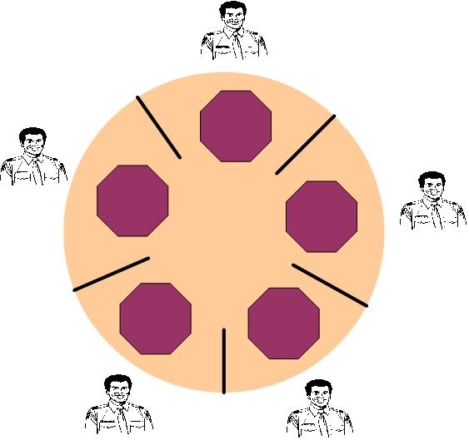
IPC problem: dining philosophers
Problem description
Philosopher: eating and thinking, alternatively
Eating: get left and right chopsticks and eat
Thinking: put two chopsticks
Starvation: all philosophers get one chopsticks

Slide 80
Analysis of “dining philosophers”
Mutual exclusion
Chopstick: only one philosopher can use it
Synchronism
Any philosopher must get two chopsticks before dining
The solution should assure that at most two philosophers can eat at same instant
Deadlock and starvation: the risk should be avoided

Slide 81
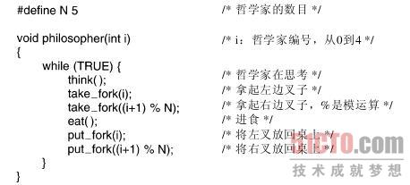
常见错误解法

Slide 82
聪明一些的解决方案
#define N 5 // 哲学家个数
semaphore fork[5]; // 信号量初值为1

Slide 83
聪明一些的解决方案
#define N 5 // 哲学家个数
semaphore fork[5]; // 信号量初值为1
void philosopher(int i) // 哲学家编号：0 － 4
while(TRUE)
{
think( ); // 哲学家在思考
eat( ); // 吃面条中….
}

Slide 84
聪明一些的解决方案
#define N 5 // 哲学家个数
semaphore fork[5]; // 信号量初值为1
void philosopher(int i) // 哲学家编号：0 － 4
while(TRUE)
{
think( ); // 哲学家在思考
if (i%2 == 0) {
} else {
}
eat( ); // 吃面条中….
}

Slide 85
聪明一些的解决方案
#define N 5 // 哲学家个数
semaphore fork[5]; // 信号量初值为1
void philosopher(int i) // 哲学家编号：0 － 4
while(TRUE)
{
think( ); // 哲学家在思考
if (i%2 == 0) {
P(fork[i]); // 去拿左边的叉子
P(fork[(i + 1) % N]); // 去拿右边的叉子
} else {
}
eat( ); // 吃面条中….
}

Slide 86
聪明一些的解决方案
#define N 5 // 哲学家个数
semaphore fork[5]; // 信号量初值为1
void philosopher(int i) // 哲学家编号：0 － 4
while(TRUE)
{
think( ); // 哲学家在思考
if (i%2 == 0) {
P(fork[i]); // 去拿左边的叉子
P(fork[(i + 1) % N]); // 去拿右边的叉子
} else {
P(fork[(i + 1) % N]); // 去拿右边的叉子
P(fork[i]); // 去拿左边的叉子
}
eat( ); // 吃面条中….
}

Slide 87
聪明一些的解决方案
#define N 5 // 哲学家个数
semaphore fork[5]; // 信号量初值为1
void philosopher(int i) // 哲学家编号：0 － 4
while(TRUE)
{
think( ); // 哲学家在思考
if (i%2 == 0) {
P(fork[i]); // 去拿左边的叉子
P(fork[(i + 1) % N]); // 去拿右边的叉子
} else {
P(fork[(i + 1) % N]); // 去拿右边的叉子
P(fork[i]); // 去拿左边的叉子
}
eat( ); // 吃面条中….
V(fork[i]); // 放下左边的叉子
V(fork[(i + 1) % N]); // 放下右边的叉子
}

Slide 88
Solution of “dining philosophers”
typedef int semph
#define N 5
#define LEFT(i)
(i + N – 1) % N
#define RIGHT(i)
(i + 1) % N
#define THINKING 0
#define HUNGRY 1
#define EATING 2
int state[N];
semph mutex = 1;
semph s[N];
Philosopher
void philosopher(int i)
{
While(TRUE){
think（）；
take_Chs(i);
eat();
put_Chs(i);}
}
take_chs
void take_chs (int i)
{
P(mutex);
state[i] = HUNGRY;
test(i);
V(mutex);
P(s[i]);//得不到叉子阻塞，否则继续执行
}

Slide 89
Solution of “dining philosophers”
Put_chs
void put_forks (int i)
{
P(mutex);
state[i] = THINKING;
test(LEFT(i));//唤醒旁边等叉子的人
test(RIGHT(i));
V(mutex);
}
Test
void test (int i)
{
if((state[i] == HUNGRY)
&& (state[LEFT(i)] ！= EATING)
&& (state[RIGHT(i)] != EATING))
{
state[i] = EATING;
V(s[i]);
}
}

Slide 90
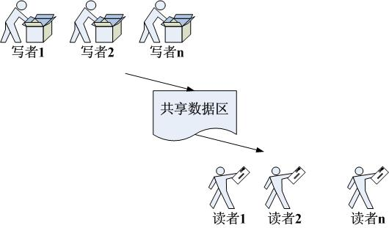
IPC problem: Reader-Writer
Problem description
Writer: put information into shared buffer
Reader: get information from shared buffer
Exclusion: reader/writer can’t access the buffer when any writer is putting item, but multiple reader can get item at same time
Synchronism: Writer sleep when FULL, while Reader sleep when EMPTY

Slide 91
Analysis of “Reader-Writer”
Mutual exclusion
Only one writer can access the buffer at any instant
If there is writer in the buffer, then all other readers and writers will be blocked
Multiple readers can access the buffer at the same time
Synchronism
Writer will sleep until all readers exit the buffer
Reader will sleep until all writers exit the buffer
Give priority to reader
Give priority to writer

Slide 92
用信号量解决读者-写者问题
Writer
Reader
write;
read;

Slide 93
用信号量解决读者-写者问题
Writer
Reader
P(WriteMutex);
P(WriteMutex);
write;
read;
V(WriteMutex);
V(WriteMutex);

Slide 94
用信号量解决读者-写者问题
Writer
Reader
if (Rcount == 0)
P(WriteMutex);
++Rcount;
P(WriteMutex);
write;
read;
V(WriteMutex);
V(WriteMutex);

Slide 95
用信号量解决读者-写者问题
Writer
Reader
if (Rcount == 0)
P(WriteMutex);
++Rcount;
P(WriteMutex);
write;
read;
V(WriteMutex);
--Rcount;
if (Rcount == 0)
V(WriteMutex);

Slide 96
用信号量解决读者-写者问题
Writer
Reader
P(CountMutex);
if (Rcount == 0)
P(WriteMutex);
++Rcount;
P(WriteMutex);
V(CountMutex);
write;
read;
V(WriteMutex);
--Rcount;
if (Rcount == 0)
V(WriteMutex);

Slide 97
用信号量解决读者-写者问题
Writer
Reader
P(CountMutex);
if (Rcount == 0)
P(WriteMutex);
++Rcount;
P(WriteMutex);
V(CountMutex);
write;
read;
V(WriteMutex);
P(CountMutex);
--Rcount;
if (Rcount == 0)
如果读者持续到达，读者优先
V(WriteMutex);
V(CountMutex);

Slide 98
Keep fairness: reader-writer
Reader
While(TRUE)
{
P(concur);
P(rmutex);
rcount++;
if(rcount == 1)
P(write);
V(rmutex);
V(concur);
Read_Action();
P(mutex);
rcount--;
if(rcount == 0)
V(write);
V(mutex);
}
Writer
While(TRUE)
{
P(wmutex);
wcount++;
if(wcount == 1)
P(concur);
V(wmutex);
P(Write);
Write_Action();
V(write);
P(wmutex);
wcount--;
if(wcount == 0)
V(concur);
V(wmutex);
}
typedef int semph
semph rmutex = 1;
semph wmutex = 1
semph write = 1;
semph concur = 1;
int rcount = 0;
int wcount = 0;
Q1:这是“低延迟”的方案，还是“高带宽”的方案？
Q2：如何实现另外的方式？

Slide 99
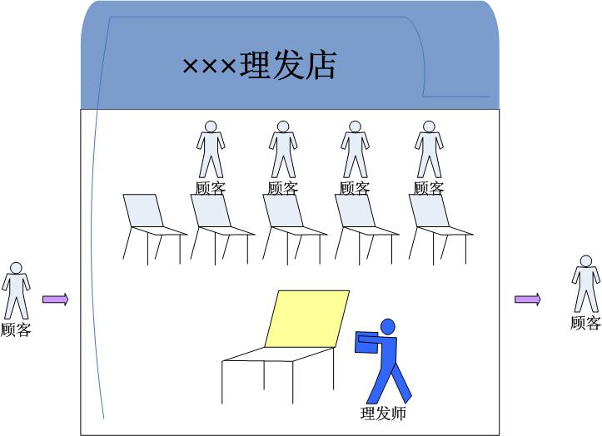
IPC problem: Sleeping Barber
Problem description
One chair for barbering, and N chairs for waiting
Customer: occupy barbering chair, or sit on waiting chair, or leaving when all chairs are full
Barber: 0 customer sleeping, or working

Slide 100
Analysis of “Sleeping Barber”
Mutual exclusion
Barbing chair: only one customer can use it
Synchronism
Barber will sleep until customer appeared
The waiting chair is a “producer-consumer” problem

Slide 101
Solution of “Sleeping barber”
barber
While(TRUE)
{
P(customer);
P(mutex);
waiting = waiting – 1;
V(barbers);
V(mutex);
barbering();
}
customer
While(TRUE)
{
P(mutex);
if(waiting < CHAIRS)
{
waiting += 1;
V(customer);
V(mutex);
P(barber);
}
else
{V(mutex);}
}
#define CHAIRS N
typedef int semph
semph customer = 0;
semph barer = 0;
semph mutex = 1;
int waiting = 0;

Slide 102
Message Passing
Design rules
Semaphore mechanism depends on CPU, under distributed environment, this mechanism is useless
All mentioned method is designed for mutual exclusion and synchronism, general information transferring between processes need more simple and efficient mechanism
Key issues
Stability: avoid data/information losing
Consistency: assure the target is correct
Efficiency: unified format of message and transferring transaction
Method
Simple message passing: send and receive primitive
Mail box: supported by OS
Rendezvous: without intermediate buffer

Slide 103
Solution of “Producer-Consumer”
＃define N 100
Producer
int item;
message m;
While(TRUE)
{
Produce-Item(&item);
recieve(consumer,&m);
build-message(&m,item);
send(consumer,&m);
}
Comsumer
int item,i;
message m;
for(i = 0; i < N; i++)
send(producer,&m); While(TRUE)
{
receive(producer,&m); extract-item(&m,&item);
send(producer,&m); Consume-item(item);
}

Slide 104
基本同步方法
临界区
管程
并发编程
高层抽象
信号量
锁
条件变量
阻塞
(等待队列)
忙等
(自旋锁)
软件
解决
禁用中断
原子操作
(如TS指令)
原子
Load/Store
硬件支持

Slide 105
你需要知道的一些事
没有任何一个哲学家因操作系统的研究被饿死
哲学家就餐问题，或类似问题，极少在工程问题中出现
锁机制的使用远超过信号量
操作系统通常仅向用户提供最简单的同步机制，其他内容由用户自主开发或第三方完成
操作系统的内核代码中反而缺少好的管理
并发与同步引起的错误是极难发现和消除的，目前没有很好的工具和手段
管程在C++中没有支持，在JAVA中也没有完整的实现
锁是一种消极的机制，改进的方案是事务型内存

Slide 106
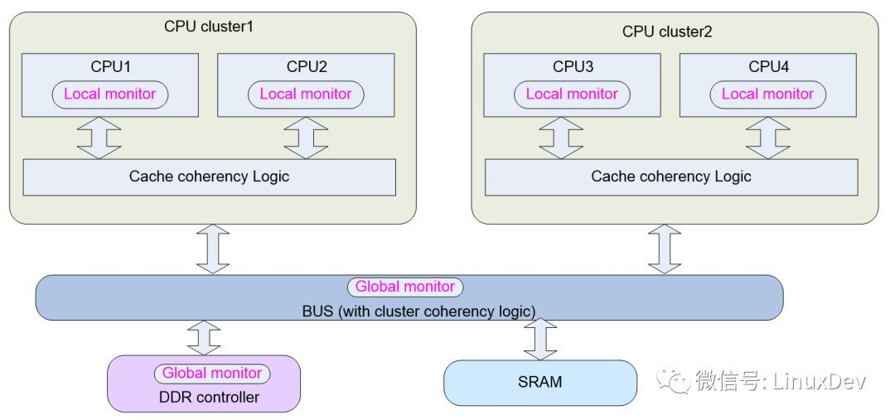
关于锁机制的实现
Test-and-Set是两个内存操作
如何在RISC指令中实现？
Exclusive Monitor
Load-Exclusive && Store-Conditional

Slide 107
让我们来思考一下多核
如何让关中断方法有效？
如何让TSL方法有效？
核间的数据交换的额外代价是什么？
核间的进程调度会带来什么问题？

Slide 108
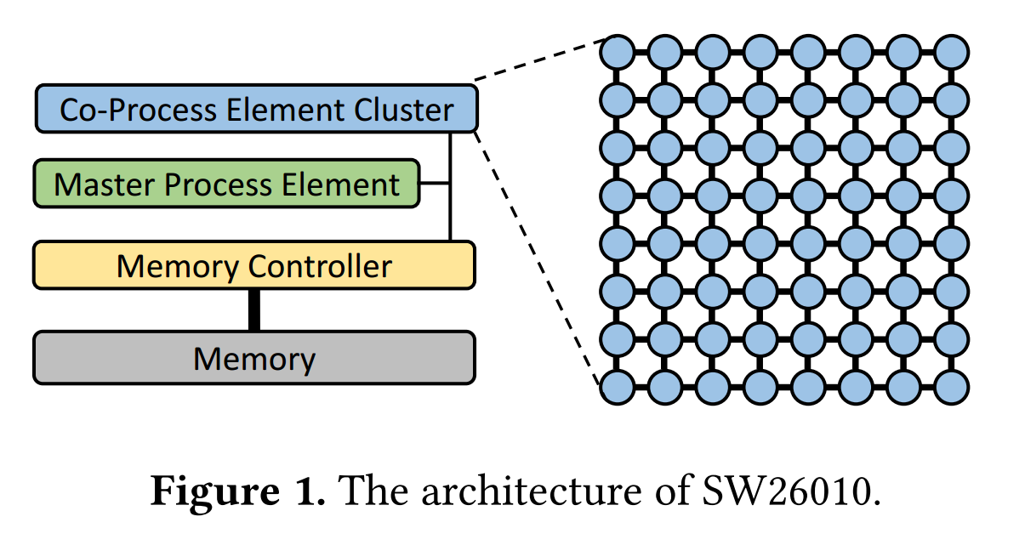
pLock：神威太湖之光上的锁机制
Xiongchao Tang, Jidong Zhai, Xuehai Qian, and Wenguang Chen. 2019. PLock: A Fast Lock for Architectures with Explicit Inter-core Message Passing. (ASPLOS '19).

Slide 109
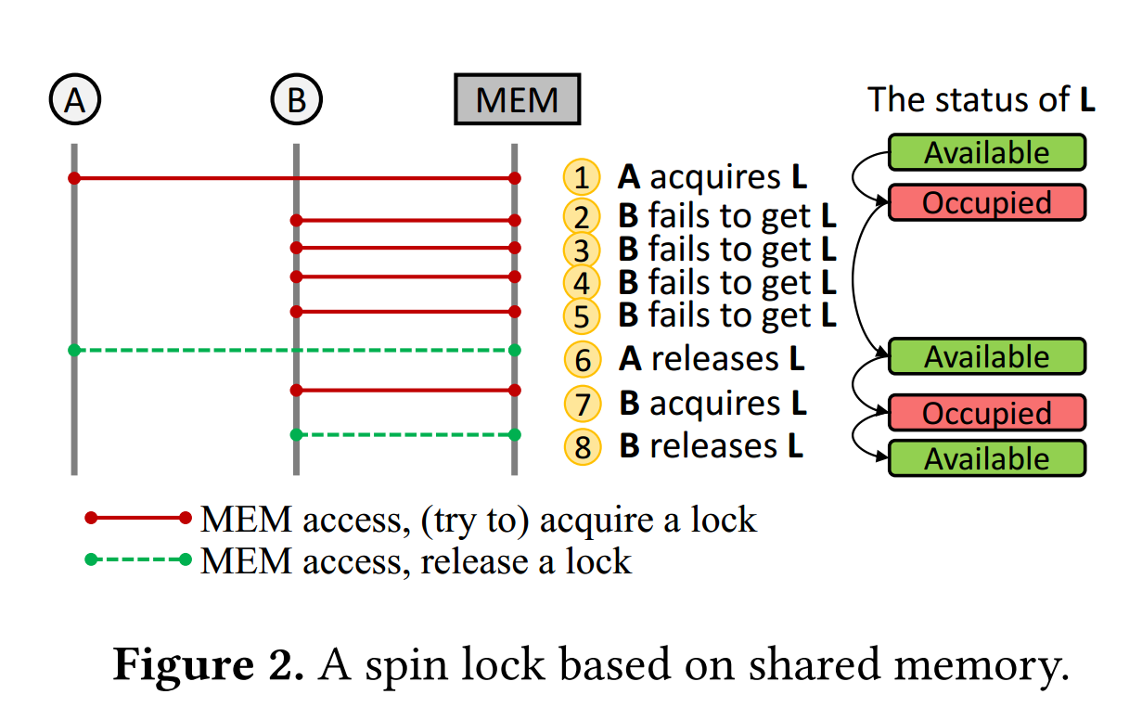
pLock：神威太湖之光上的锁机制

Slide 110
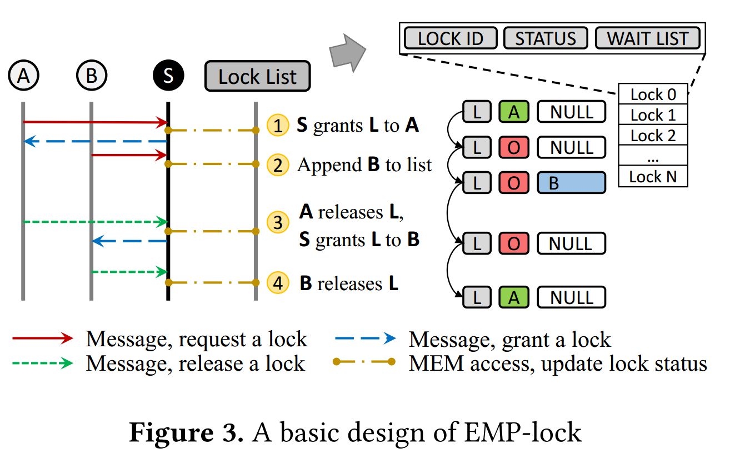
pLock：神威太湖之光上的锁机制

Slide 111
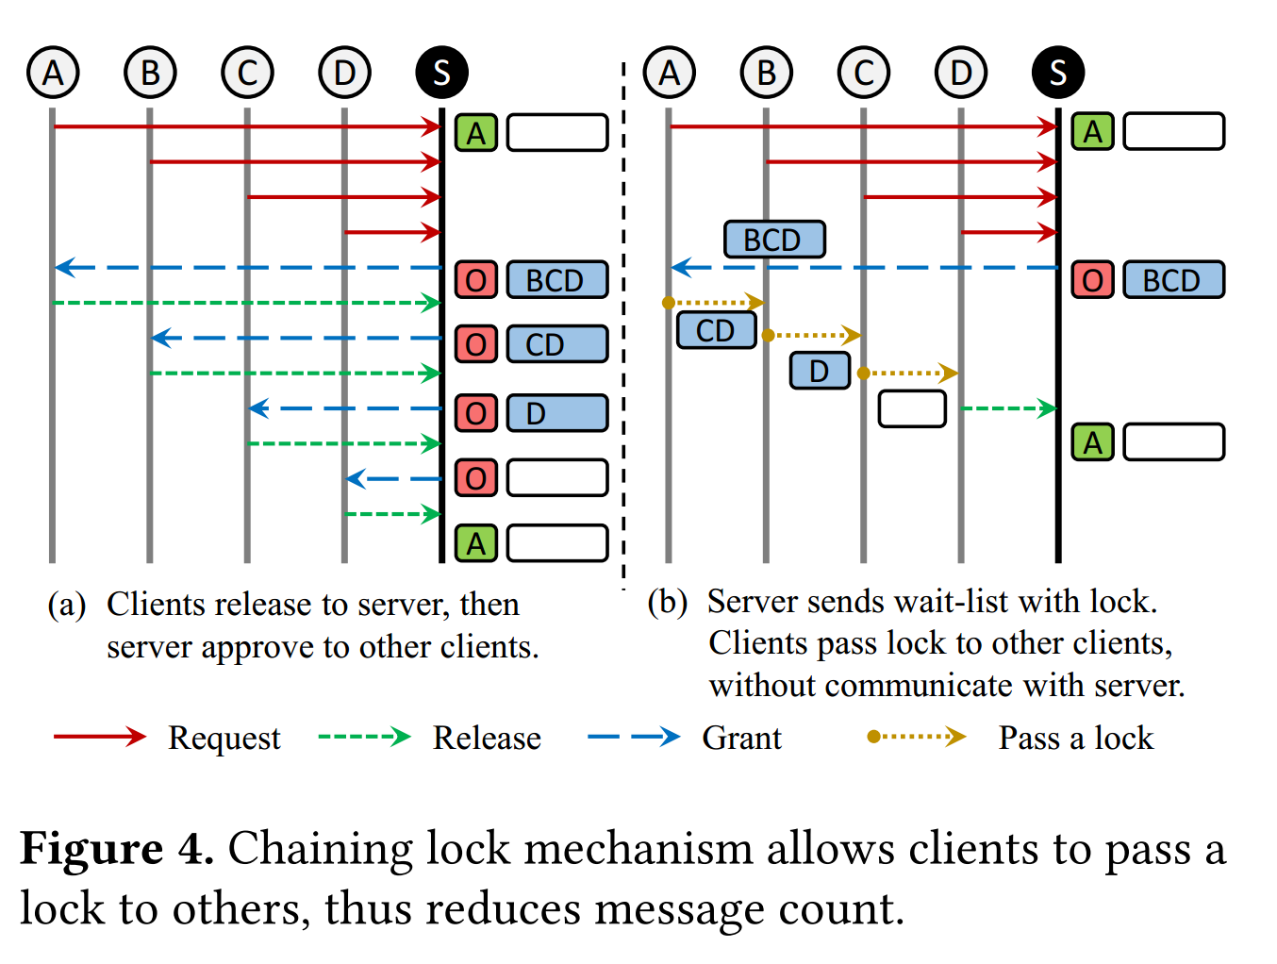
pLock：神威太湖之光上的锁机制

Slide 112
为什么程序员倾向于锁 而不是信号量

Slide 113
为什么操作系统可以访问的数据 用户却访问不到呢？

Slide 114
不行！

Slide 115
等级森严的CPU世界

Slide 116
x86 特权级 – CPU的运行状态
Protection Rings
Operating System Kernel
Level 0
Operating System
Services (Device Drivers,Etc)
Level 1
Applications
Level 2
Highest
Level 3
Lowest
Privilege Levels
图 Protection Rings
■
Linux 和 uCore 只使用 ring 0 and ring 3

Slide 117
指令的等级状态
普通指令
加减乘除、移位、跳转、中断（INT）
特权指令
停机指令HLT、等待指令WAIT/MWAIT、换码指令ESC、
总线封锁指令LOCK、内存范围检查指令BOUND、
全局描述符表操作指令LGDT/SGDT、
中断描述符表操作指令LIDT/SIDT、
局部描述符表操作指令LLDT/SLDT、
描述符段界限值加载指令LSR、描述符访问权读取指令LAR、
任务寄存器操作指令LTR/STR、请求特权级调整指令ARPL、任务切换标志清零指令CLTS、控制寄存器和调试寄存器数据传送指令MOV、高速缓存控制指令INVD/WBINVD/INVLPG、型号相关寄存器读取和写入指令RDMSR/WRMSR、处理器信息获取指令CPUID、时间戳读取指令RDTSC等
原文链接：https://blog.csdn.net/jukaiit/article/details/16811139

Slide 118
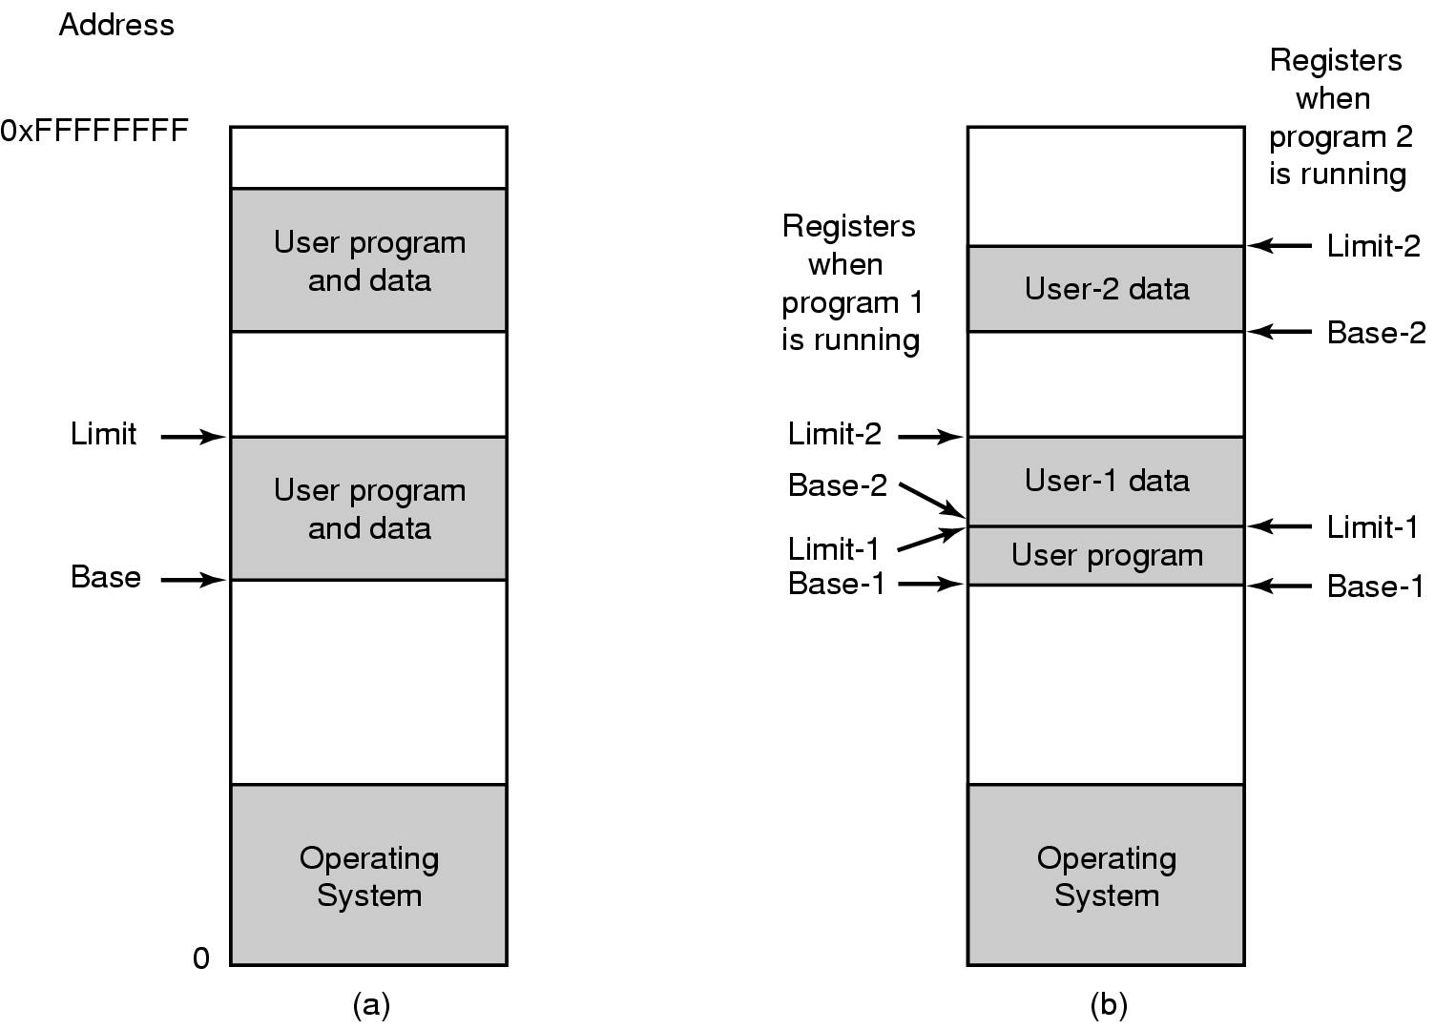
内存区域划分

Slide 119







分段式的内存访问模式： 段+偏移量
MAX_{sys}
内存异常
逻辑
地址
no
物理
地址
1500
真正访问的
目标地址
CPU
≤
yes
+
jmp 1175
1000
指令
500
1000
指令
MAX_{prog}
从段描述符中
获得段长段
段基址
寄存器
段描述符指定段
偏移量指定位置
0
0
jmp 175

Slide 120
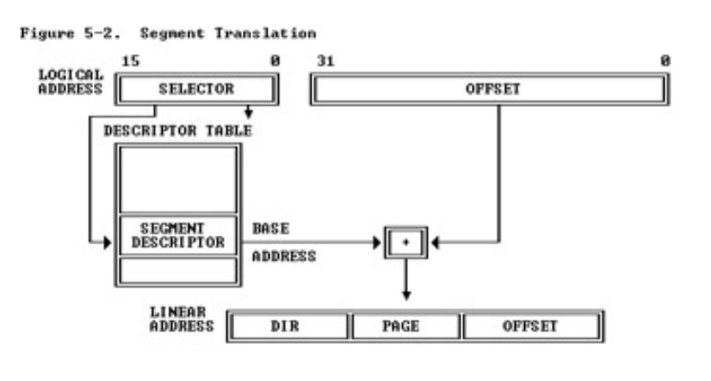
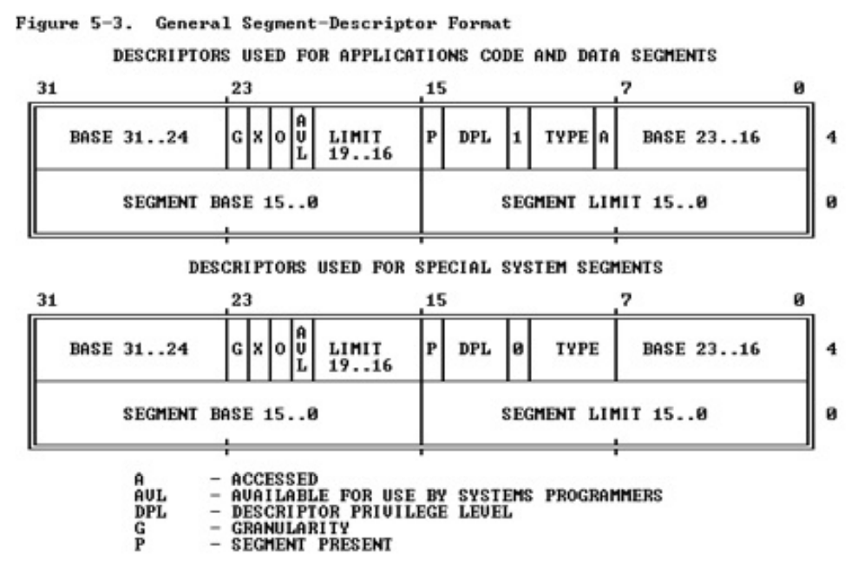
内存区域的权限等级

Slide 121
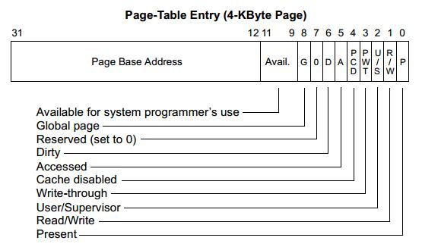
内存区域的权限等级

Slide 122
内存区域的权限等级

Slide 123
怎么修改CPU的当前权限状态？
用户程序运行中
时钟中断到来
为当前程序计时
返回被打断的程序
权限切换如何实现？
中断响应函数应该处于ring0
中断跳转的过程自动提权
中断跳转的目标是OS预留的
中断返回时，OS程序员降权

Slide 124
用户指令与内核如何交互
参考中断的机制，OS中设计了三种可以在运行时“呼叫”操作系统，并提升权限的方式
中断（Interrupt）
异常（Exception)
系统调用（System Call）

Slide 125
背景
■
为什么需要中断、异常和系统调用
在计算机运行中，内核是被信任的第三方
只有内核可以执行特权指令
方便应用程序
■
中断和异常希望解决的问题
当外设连接计算机时，如何让操作系统知道？
当应用程序处理意想不到的行为时，如何处理错误？
■
系统调用希望解决的问题
用户应用程序是如何得到系统服务？

Slide 126
中断、异常和系统调用
■
系统调用（system call）
应用程序主动向操作系统发出的服务请求
■
异常(exception)
非法指令或者其他原因导致当前指令执行失败
(如：内存出错)后的处理请求
■
中断(hardware interrupt)
来自硬件设备的处理请求

Slide 127


中断过程的运行机制
应用程序
中断向量表
设备驱动
内核
中断
设备访问数据流
外部设备

Slide 128
异常过程的运行机制
应用程序
异常
(代码执行出错)
异常服务
例程
中断向量表
设备驱动
内核
中断
设备访问数据流
外部设备

Slide 129

系统调用
■
操作系统服务的编程接口，用户进程主动“呼叫”OS的编程方式
■
通常由高级语言编写（C或者C++）
■
程序访问通常是通过高层次的API接口而不是直接进行系统调用
■
三种最常用的应用程序编程接口（API）
Win32 API 用于 Windows
POSIX API 用于 POSIX-based systems (包括UNIX，LINUX，Mac OS X的所有版本)
Java API 用于JAVA虚拟机(JVM)

Slide 130


系统调用的实现
■
每个系统调用对应一个系统调用号
系统调用接口根据系统调用
号来维护表的索引
应用程序
■
系统调用接口调用内核态中的系
统调用功能实现，并返回系统调
用的状态和结果
函数库
系统调用接口
■
用户不需要知道系统调用的实现
需要设置调用参数和获取返
回结果
系统调用
实现
系统
调用表
操作系统接口的细节大部分
都隐藏在应用编程接口后
中断向量表
内核
· 通过运行程序支持的库来管理

Slide 131
// System call numbers
#define SYS_fork 1
#define SYS_exit 2
#define SYS_wait 3
#define SYS_pipe 4
#define SYS_write 5
#define SYS_read 6
#define SYS_close 7
#define SYS_kill 8
#define SYS_exec 9
#define SYS_open 10
#define SYS_mknod 11
#define SYS_unlink 12
#define SYS_fstat 13
#define SYS_link 14
#define SYS_mkdir 15
#define SYS_chdir 16
#define SYS_dup 17
#define SYS_getpid 18
#define SYS_sbrk 19
#define SYS_sleep 20
#define SYS_procmem 21
系统调用库接口示例
sfs_filetest1.c: ret=read(fd,data,len);
……
8029a1: 8b 45 10 mov 0x10(%ebp),%eax
8029a4: 89 44 24 08 mov %eax,0x8(%esp)
8029a8: 8b 45 0c mov 0xc(%ebp),%eax
8029ab: 89 44 24 04 mov %eax,0x4(%esp)
8029af: 8b 45 08 mov 0x8(%ebp),%eax
8029b2: 89 04 24 mov %eax,(%esp) ; 以上代码在填充栈
8029b5: e8 33 d8 ff ff call 8001ed <read> ；这里的read是宏==6
syscall(int num, ...) {
...
asm volatile (
“int %1;“//这一句会个产生一个中断
: "=a" (ret)
: “i” (T_SYSCALL), //这句指定中断号
“a” (num), //这一句的作用是把6放进了eax
"d" (a[0]),
"c" (a[1]),
"b" (a[2]),
"D" (a[3]),
"S" (a[4])
: "cc", "memory");
return ret;

Slide 132
系统调用read(fd, buffer, length)的实现
1. kern/trap/trapentry.S: alltraps()
2. kern/trap/trap.c: trap()
tf->trapno == T_SYSCALL
3. kern/syscall/syscall.c: syscall()
tf->tf_regs.reg_eax ==SYS_read
4. kern/syscall/syscall.c: sys_read()
从 tf->sp 获取 fd, buf, length
5. kern/fs/sysfile.c: sysfile_read()
读取文件
6. kern/trap/trapentry.S: trapret()

Slide 133
内核的进入与退出
应用程序
函数库
异常
(代码执行出错)
系统调用接口
异常服务
例程
系统调用
实现
系统
调用表
中断向量表
设备驱动
内核
中断
设备访问数据流
外部设备

Slide 134
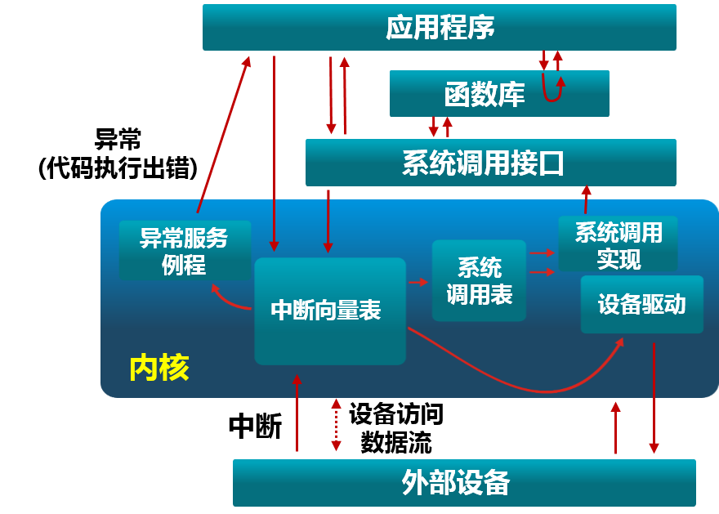
中断、异常和系统调用比较
■
源头
中断：外设
异常：应用程序意想不到的行为
系统调用：应用程序请求操作提供
服务
■
响应方式
中断：异步
异常：同步
系统调用：异步或同步
■
处理机制
中断：持续，对用户应用程序
是透明的
异常：杀死或者重新执行意想不到的
应用程序指令
系统调用：等待和持续

Slide 135
中断处理机制
硬件处理
在CPU初始化时设置中断使能
标志
■
依据内部或外部事件设置中
断标志
依据中断向量调用相应中断
服务例程

Slide 136
中断和异常处理机制
软件
现场保存（编译器）
中断服务处理（服务例程）
清除中断标记（服务例程）
现场恢复（编译器）

Slide 137
中断嵌套
■
硬件中断服务例程可被打断
不同硬件中断源可能硬件中断处理时出现
硬件中断服务例程中需要临时禁止中断请求
中断请求会保持到CPU做出响应
■
异常服务例程可被打断
异常服务例程执行时可能出现硬件中断
■
异常服务例程可嵌套
异常服务例程可能出现缺页

Slide 138


标准C库的例子
应用程序调用printf() 时，会触发系统调用write()。
■
#include<stdio.h>
int main()
{
.
.
.
printf(“greetings”);
.
.
.
return 0;
}
应用程序
write()
用户态
系统调用接口
内核态
用户态
.
.
.
write()
write()
系统调用实现
return
标准C库
内核态
write()
i
.
.
.
write()
系统调用实现
.
.
.

Slide 139
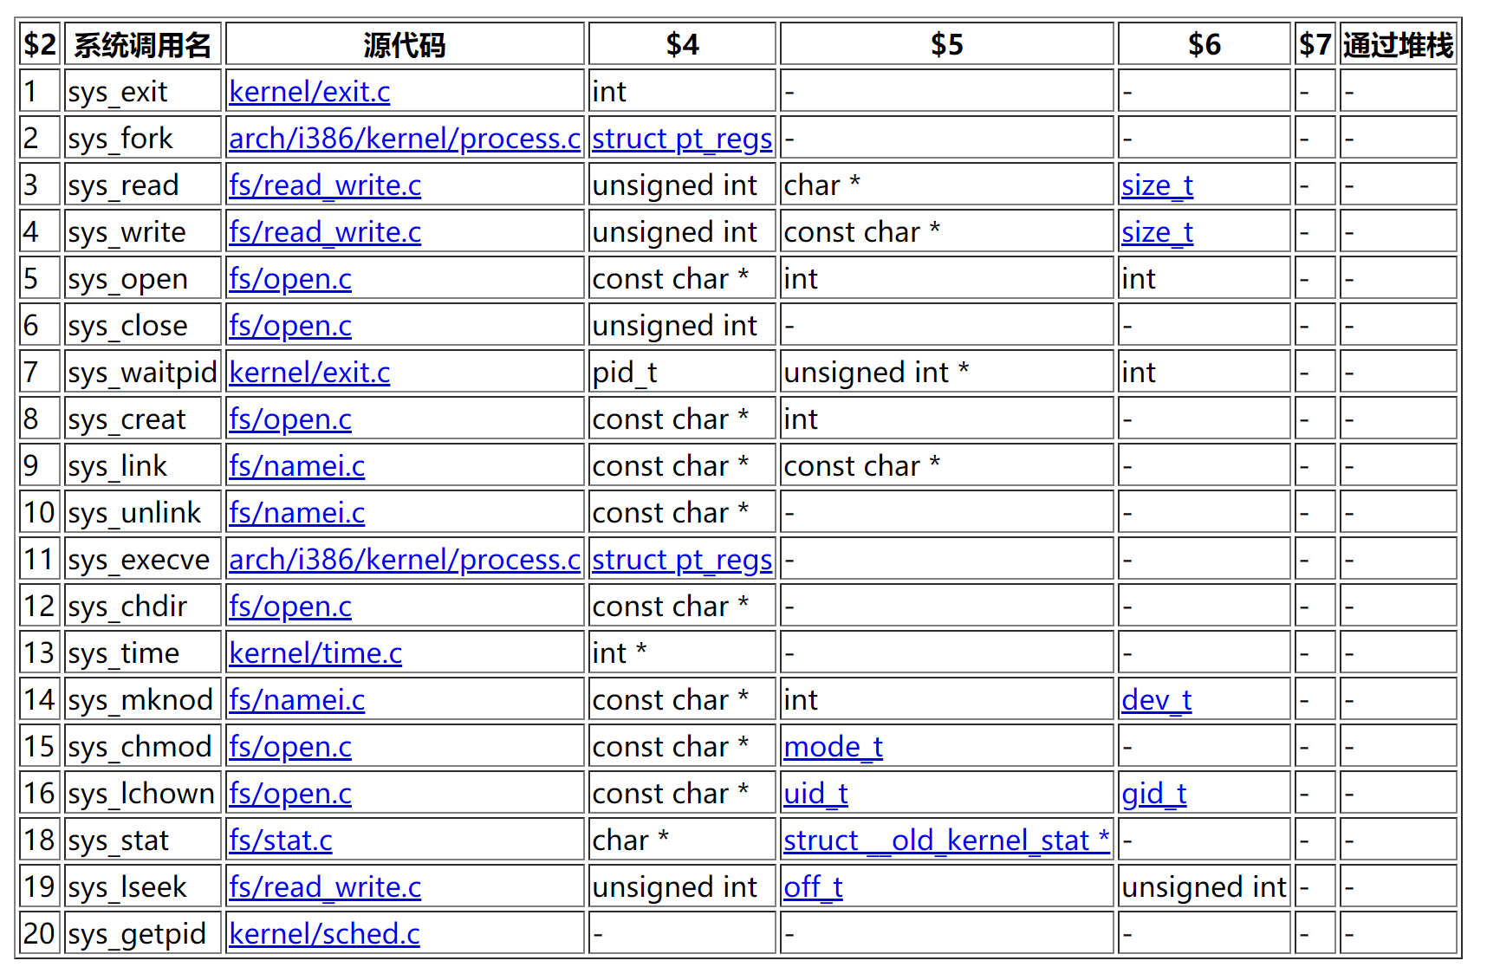
系统调用表
https://www.cnblogs.com/ggjucheng/archive/2012/01/08/2316695.html

Slide 140
函数调用和系统调用的不同处
■
系统调用
系统调用是由操作系统向用户空间提供的固定接口，通过这些接口可以提升权限
这些接口的行为是固定的，以尽可能的保证安全。也就是提升权限后只能执行预定好的指令或访问预定好的数据
欺骗这些接口以获得不该有的权限，从而实现对系统的攻击。这种活动从未停止过

Slide 141
函数调用和系统调用的不同处
■
系统调用
INT和IRET指令用于系统调用
· 系统调用时，堆栈切换和
特权级的转换
■
函数调用
CALL和RET用于常规调用
· 常规调用时没有堆栈切换
■
Intel 64 and IA-32 Architectures Software Developer Manualshttp://www.intel.com/content/www/us/en/processors/architectures-software-developer-manuals.html

Slide 142
中断、异常和系统调用的开销
■
超过函数调用
开销：
■
引导机制
建立内核堆栈
验证参数
内核态映射到用户态的地址空间
· 更新页面映射权限
内核态独立地址空间
· TLB

Slide 143
Thanks for your time! Questions & Answers

